Slide 1

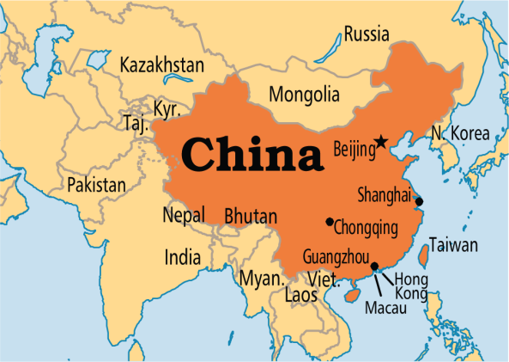

Internationalizing Time (I18N with Time)
The display format of the time differs from one region to another, so we need to internationalize the time.
For internationalizing the time, the DateFormat class provides some useful methods.The getTimeInstance() method of the DateFormat class returns the instance of the DateFormat class for the specified style and locale.
Language = English
6:30:04 PM
Language = Chinese
18:30:04
Language = French
18:30:04

